Slide 1
University Catalog Management System V.2
Chris Sutton

Slide 2
Objective
Create a system to let advisers interact with current and previous university catalogs.
Advisers are restricted to their own DGU, Degree Granting Unit. For example the Department of Engineering and Computer Science.

Slide 3
Previous Focus
Super Admin roles
Use cases included:
Creating Accounts
Deleting Accounts
View Older Catalogs
Assign DGU Admin
Update DGU Active Catalog
Update Course Tables
“Not enough meat”
Focus switched.

Slide 4
New Focus
Creation of degree flow chart.
Dynamically created for each track within a certain major.

Slide 5
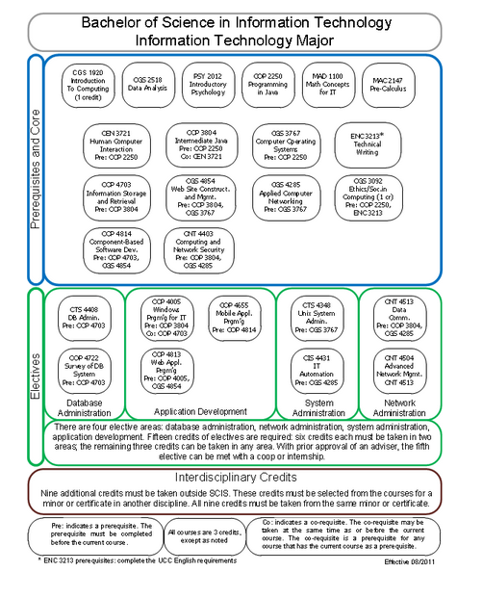
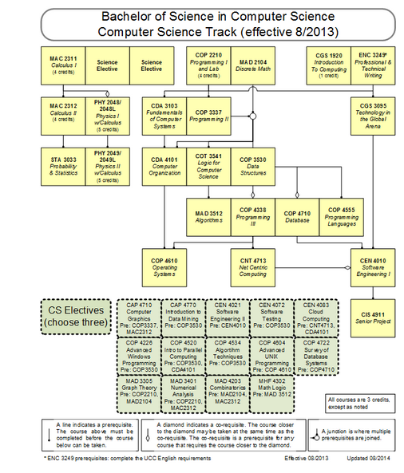

Slide 6
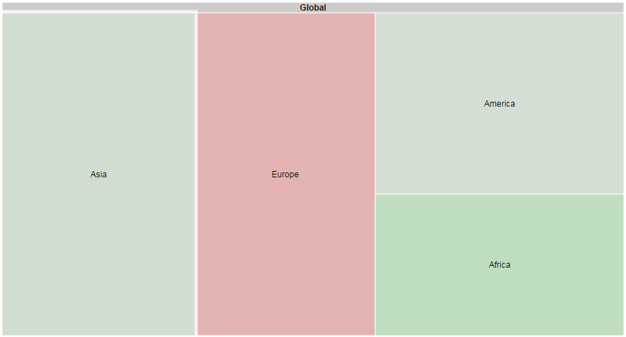
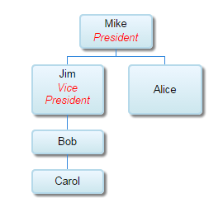
First Attempt
Use Google API for charts.

